Slide 1
How to establish an online study Krešimir Fertalj

Slide 2
Intro
Context
Lifelong education
E-learning
Scope
International
National
Institution
Departments
Courses
Strategy, …, Feasibility
As follows

Slide 3
General strategies

Slide 4
Regional and sector strategies
Europa 2020 – Digital agenda
Action 68: Member States to mainstream eLearning in national policies
for the modernisation of education and training, including curricula, assessment of learning outcomes and the professional development of teachers and trainers
The Commission will continue supporting research and innovation actions on ICT for learning under the new Research and Innovation Programme Horizon 2020.
Regional and sector strategies
e.g. Strategy of Education, Science and Technology, HR Parliament, 2014.
… encourage the formation of two groups of content
free (open) to be financed out of public funds or the EU
commercial, which need to provide … the distribution and implementation of the review
Notes:
http://ec.europa.eu/europe2020/index_en.htm
http://ec.europa.eu/digital-agenda/en/pillar-vi-enhancing-digital-literacy-skills-and-inclusion/action-68-member-states-mainstream
http://www.refernet.hr/en/news/croatian-news/strategy-of-education-science-and-technology/

Slide 5
Operational programs
Operational Programme „Competitiveness and Cohesion”
Objective 02 - Enhancing access to, and use and quality of, ICT
Priority 2c - Strengthening ICT applications for e-government, e-learning, e-etc.
meaning: Government cloud, e-applications, e-everything but e-learning
Operational Programme „Efficient Human Resources”,
TO 10 - Investing in education, training and vocational training for skills and lifelong learning (e-nothing)
10ii - Improving the quality and efficiency of, and access to, tertiary and equivalent education with a view to increasing participation and attainment levels, especially for disadvantaged groups
10iii - Enhancing equal access to lifelong learning …
10iv - Improving the labour market relevance of education and training system …
Notes:
TO = Thematic objectives
http://www.minpo.hr/UserDocsImages/Operativni%20program%20Konkurentnost%20i%20kohezija%202014.-2020..pdf
http://www.mrrfeu.hr/UserDocsImages/EU%20fondovi/OPKK_2014_20_FINALNI_NACRT_21_07_2014.pdf
http://www.strukturnifondovi.hr/UserDocsImages/Novosti/FINAL%20OP%20EHR.pdf

Slide 6
Institutional strategies
Development Strategy of the Faculty of EE and Computing of the Universtiy of Zagreb 2013-2017.
Mision, Vision, Goals and Activities defined
Committee for life-long education and e-learning
Activity: Application of new e-learning technologies
KPIs: #courses, #enrolled, #studies, #seminars & courses (not only e-*)
…
Notes:
http://www.fer.unizg.hr/_download/repository/Development_Strategy,_FER,_2013_-_2017.pdf

Slide 7
Erasmus+
At glance,
Cross-sectoral cooperation in the fields of Higher Education (HE), Vocational Education and Training (VET), School Education, Adult Education and Youth
25,000 partnerships
125,000 institutions
Total budget of €14.7 billion
For more, visit:
URL: ec.europa.eu/erasmus-plus
Twitter: #ErasmusPlus
Facebook: Erasmus+
Notes:
http://www.mobilnost.hr/index.php?id=784
http://ec.europa.eu/programmes/erasmus-plus/documents/erasmus-plus-at-a-glance_en.pdf

Slide 8
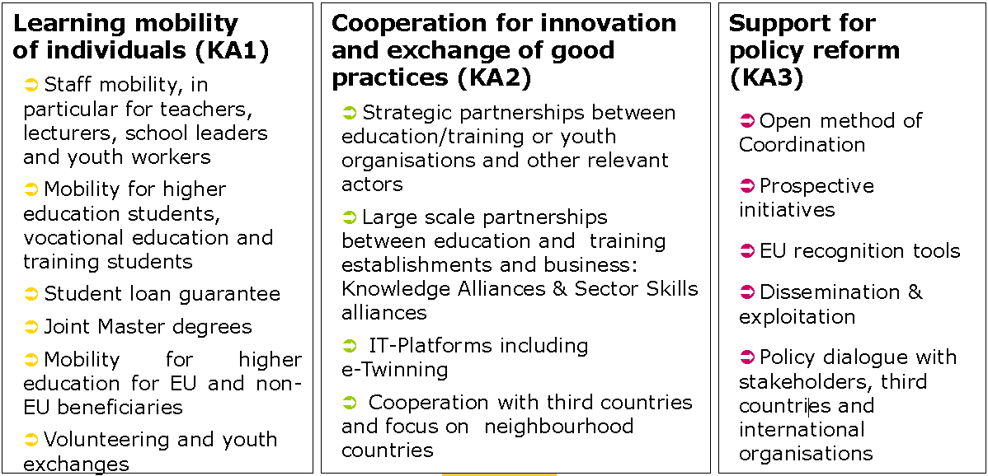
Erasmus+ 3 main types of Key Action
Notes:
http://ec.europa.eu/programmes/erasmus-plus/documents/erasmus-plus-in-detail_en.pdf
http://www.mobilnost.hr/prilozi/05_1390817113_Pregled_mogucnosti.pdf
http://ec.europa.eu/programmes/erasmus-plus/documents/erasmus-plus-programme-guide_en.pdf
http://www.etwinning.net/en/pub/index.htm
eTwinning offers a platform for staff (teachers, head teachers, librarians, etc.), working in a school in one of the European countries involved, to communicate, collaborate, develop projects, share and, in short, feel and be part of the most exciting learning community in Europe.

Slide 9
Higher education: main objectives
Increase the skills and employ ability of students and contribute to the competitiveness of European economy
Improve quality in teaching and learning
Implement the Higher Education Modernisation strategy in programme countries and raise the capacity of partner countries
Streamline the international dimension in Erasmus+
Support the Bologna process and policy dialogues with strategic partner countries
Notes:
http://ec.europa.eu/programmes/erasmus-plus/documents/erasmus-plus-in-detail_en.pdf

Slide 10
KA2: HE strategic partnerships
Aims:
To enhance stronger cooperation between HEI and with key stakeholders (enterprises, research organisations, social partners, local/regional authorities, other E&T or youth sectors) to foster quality and innovation in HE
Main activities:
Develop, test, implement new joint curricula, joint study programmes, common modules, intensive programmes
Develop project-based cooperation with enterprises to study real-life cases
Exploit the potential of Open Educational Resources, collaborative and personalised learning
Integrate various study modes (distance, part-time, modular)
Notes:
https://www.daad.de/downloads/eu_downloadcenter/128_dosanddontsforapplicants-strategicpartnershipsforhighereducation.pdf

Slide 11
KA2: HE strategic partnerships projects
Potential applicants
One applicant for the whole partnership, e.g. HE institution, NGO, institute, …
Project type
Transnational cooperation projects
with the aim of creating innovative solutions
in the field of education and training
Partners
Min 3 organizations from 3 different countries
Project duration
2 or 3 years
Budget
150.000 EUR per year
Notes:
https://eacea.ec.europa.eu/erasmus-plus/actions/key-action-2-cooperation-for-innovation-and-exchange-good-practices_en
https://www.daad.de/downloads/eu_downloadcenter/128_dosanddontsforapplicants-strategicpartnershipsforhighereducation.pdf

Slide 12
KA2: Knowledge alliances and Sector skills alliances
Aims:
To enhance structured and long-term cooperation between HEI and enterprises to develop innovative ways of producing and sharing knowledge in result-driven projects, particularly in emerging fields
Main activities:
Delivery of new multidisciplinary curricula responding to business needs
Stimulate entrepreneurship and entrepreneurial mind-set of students, academic and company staff
Facilitate the exchange, flow and co-creation of knowledge between HEIs and enterprises

Slide 13
KA2: Knowledge alliances OR Sector skills alliances projects
Potential applicants
One applicant for the whole partnership, e.g. HE institution, company, institute,
Project type
Transnational, structured cooperation projects between HE and business
Partners
Min 6 organizations from 3 different countries, min 2 HE, min 2 companies OR
Min 9 organizations from 3 different countries, including 2 EU countries
Project duration
2 or 3 years
Budget
Max 700 kEUR for 2yr project, Max 1 MEUR for 3 yr project
Notes:
https://eacea.ec.europa.eu/erasmus-plus/funding/knowledge-alliances-sector-skills-alliances-2015_en

Slide 14
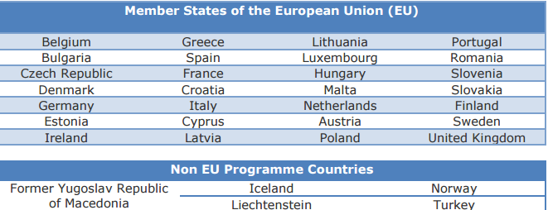
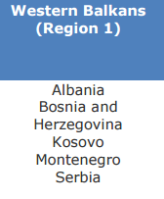
Erasmus+ eligible countries
Programme Countries
EU states: Bulgaria, Romania, Croatia, Hungary, Slovenia, Germany, …
Non EU: FYR Macedonia
Partner Countries (Westerrn Balkans – Region 1)
Albania, Bosnia and Herzegovina, Kosovo, Montenegro, Serbia
Notes:
http://ec.europa.eu/programmes/erasmus-plus/documents/erasmus-plus-eligible-countries_en.pdf

Slide 15
Formal criteria for online study evaluation
[the scope]

Slide 16
Formal criteria [in Croatia]
Evaluation criteria for online studies
National Council for Higher Education
Based on intl. experience and good practice
Key points
Learning outcomes & competences should not differ from classical program
Classical program can be migrated online
At least 50% of online courses
where 50% of teaching hours per course is performed online
Part-time study

Slide 17
Formal criteria – Purpose, Infrastructure, Organization
Purpose
e.g. wider access to HE, new/broader student population
Infrastructure and technical assumptions
24/7 Internet connection and institution services
HW, SW - infrastructure stability, 5yr financial plan
Virtual environment - LMS, wiki, etc.
Organization and administration
Procedures and documents – enrollment, roles, obligations
Information about: study program, courses, rules, etc.
Instructions and workshops to prepare students for online study

Slide 18
Formal criteria – Human Resouces
HR prerequisites
At least one person responsible for online communication with students
IT service to resolve problems within 24hrs
Online teaching competent staff
At least one teacher per student group
engaged weekly 1-1.5 course ECTS hours (e.g. 5 ECTS, 15wks => 10-15 hrs/wk)
online activities, preparation, tutoring, evaluation, etc.
Max 90 students per group
Notes:
„Radno vrijeme nastavnika izraženo u NS tjedno 1-1.5 ECTS bodova koje predmet donosi”
1 ECTS = 25-30 hrs

Slide 19
Formal criteria – Support to teachers and students
Organizational
Systematic education of teaching staff, administrative staff and students
Support to teaching staff in preparation and execution of courses
Online reporting to students regarding study (… before payment of tuition fee)
Administrative
teachers: regulated status and workload, access to student info, …
students: online enrollment, payment, issuance of documents, …
online gradebook
archiving of student results (tests, exams, …)
publishing of student work
confidentiality of data

Slide 20
Formal criteria – Support to teachers and students (cont'd)
Technical
Use of services,
Tech support for preparation of materials,
Backup of teaching materials and data, …
Library
Online access to teaching materials, public sources, scientific databases
Online search of library collection(s) of the institution
Copyright of protected materials
Online communication students-librarians
Shipping and returns of printed materials by mail

Slide 21
Course description add-ons
Learning outcomes, achievable by online teaching
Detailed schedule of online activities
Weekly, Including student workload
Online learning materials
adapted for individual student use, reviewed !
Other resources
„classic” literature, authorized materials
Clear and precise instructions for online student work
Plan and description of assessment, including criteria

Slide 22
Assesment
Continuous assessment of interactions and discussions
Assessment of student work, e.g. homework, projects, etc.
verification of authorship
Assessment in controlled environment, in presence of teaching staff
On-site
Video conference
Online exam, with authentication and other security checks
One-time testing, time limitation, IP control
Grades available online, equal to other grades

Slide 23
Development

Slide 24
Curricula development
Learning outcomes
E-learning to support the expected outcomes
Who are the students?
Where are the students?
Required technology
Target employers and their expectations
…

Slide 25
Course development
Planning
Performing needs analysis for the course/program
Developing a timeline for development process
Identifying resources required
Designing
Articulating outcomes
Identifying and developing assessment strategies
Chunking content
Developing instructional strategies
Collecting formative and summative feedback on the course design
http://techined.ualberta.ca/onlineblended
Notes:
http://techined.ualberta.ca/onlineblended

Slide 26
Course development (cont'd)
Building
Developing materials
Creating multi-media learning objects
Arranging and overseeing the building of the eClass course
Teaching
Training on using the tools needed to teach the course
Coaching and support for facilitating online discussion/activities
Providing ongoing support throughout the term
Notes:
http://techined.ualberta.ca/onlineblended

Slide 27
What to study ?
Migration of an existing study
Undergraduate, graduate study
Postgraduate specialist study
Postgraduate doctoral study
Develop a new study
Interdisciplinary ?
Level ?
Domain ?
Project management
…
MOOCs (Massive Open Online Courses)
How massive ?
Budget & sponsor ?
Pilot ?
Basic course(s) – e.g. programming, basic math, …
Notes:
Formal criteria: max 90 students per group

Slide 28
Postgraduate specialist studies at FER
University specialist postgraduate study programmes
normally take one to two years
the academic degree of University Specialist with an indication of the field
161 at the UNIZG out of which …
Postgraduate specialist study programmes at FER
PSS in Information Security
PSS in transformers
PSS in electrical engineering systems in railways
Multidisciplinary PSS in electronic communications market regulation
Notes:
http://www.unizg.hr/homepage/study-at-the-university-of-zagreb/academic-information/
http://www.unizg.hr/istrazivanje/specijalisticki-studiji/pravilnik-o-poslijediplomskim-specijalistickim-studijima-na-suz/
http://www.unizg.hr/homepage/study-at-the-university-of-zagreb/degrees-and-studies/studies-and-courses-in-english/full-degree-programmes-in-english/

Slide 29
Example, PSS in Information Security
Two semesters + specialist thesis in third semester
60 ECTS =
18 ECTS obligatory courses (3 / 3)
18 ECTS elective courses (3 / 9)
24 ECTS specialist thesis
univ. spec. secur. inf.
Notes:
članak 17.
uvjeti za upis
Specijalistički studij može upisati osoba koja je završila sveučilišni dodiplomski
ili diplomski studij iz odgovarajućeg područja utvrđenog programom studija.
Od osobe koja nije završila sveučilišni dodiplomski ili diplomski studij iz odgovarajućeg
područja može se tražiti polaganje razlikovnih ispita.
članak 19.
diplome stečene na stranim sveučilištima
Pristupnik koji je stekao diplomu o završenom dodiplomskom, odnosno
diplomskom sveučilišnom studiju na stranom sveučilištu, dužan je o svome
trošku pribaviti i nakon prijave na natječaj dostaviti rješenje nadležnoga tijela
o akademskom priznavanju inozemne visokoškolske kvalifikacije i priznavanja
razdoblja studija, odnosno ects bodova, u svrhu upisa na konkretan specijalistički
studij.

Slide 30
New specialist study - Interdisciplinary, massive, …
Project management ?
Project Management Fundamentals,
The Project Management Lifecycle
Managing Project Teams
Managing Project Communication
Project Initiation and Planning
Managing Project Scope
Managing Project Scheduling
Managing Project Resources
Managing Project Quality
Managing Project Risk
Managing Project Procurement
Managing Project Execution
Managing Project Control & Closure
Topics defined by the ACM/AIS IS 2010 curriculum
Notes:
https://www.acm.org/education/curricula/IS%202010%20ACM%20final.pdf

Slide 31
Prospective PM courses
Project Management Fundamentals
Management, Leadership and Team Building
Project Scope and Quality Management
Planning and Scheduling
Project Execution and Control
Risk Management
Project Cost and Procurement Management
...
Agile management
Program Mgt, Portfolio Mgt and PM Office
Notes:
http://extension.berkeley.edu/cert/project.html
http://unex.uci.edu/areas/business_mgmt/project_mgmt/courses.aspx
http://ce-online.ryerson.ca/ce/default.aspx?id=2972
http://www.mastersportal.eu/study-options/268927001/project-management-united-kingdom.html

Slide 32
Implementation

Slide 33
Requirements
Infrastructure available at the institution(s)?
LAN, WLAN, TCR, Polycom PVX, …
Available technology (software, hardware) ?
LMS: Moodle, AHyCo, MudRI
DMS: Quilt CMS, Sharepoint, …, e-portfolio (SRCE)
Knowledge and competencies at the institution(s)?
Yes, practical experience + yet2come ☺
Current level of support to the students and the teachers ?
Student IS (ISVU), Information Support Centre (CIP), Library & online catalog
What decisions must be made to start an online course / study ?
Faculty Council – Council of Technical Area - University Senate / Ministry
Other ?
Budget for development of courses
Notes:
https://moodle.srce.hr/eportfolio/
Committee for life-long education and e-learning

Slide 34
Roles and competences
Roles and competences
Subject-matter expert / Teacher
Graphical designer
Web designer
Media designer
Programmer
Multimedia expert (video conference support)
User support for students & teachers
Skills development
E-learning Academy - MOOC „Online course development”, in Moodle
http://www.carnet.hr/loomen/moodle_mooc (in Croatian)

Slide 35
[running] Income, Costs and Benefits – current & estimated
Notes:
Overhead costs for a business are the cost of resources used by an organization just to maintain its existence
Operating costs are the expenses which are related to the operation of a business, or to the operation of a device, component, piece of equipment or facility. = FIX + VAR
Running costs: The amount regularly spent to operate an organization, used for things such as salaries, utilities, and rent.

Slide 36
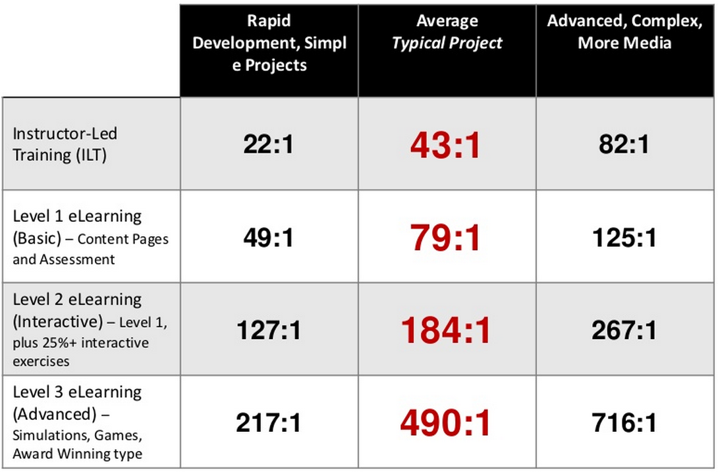
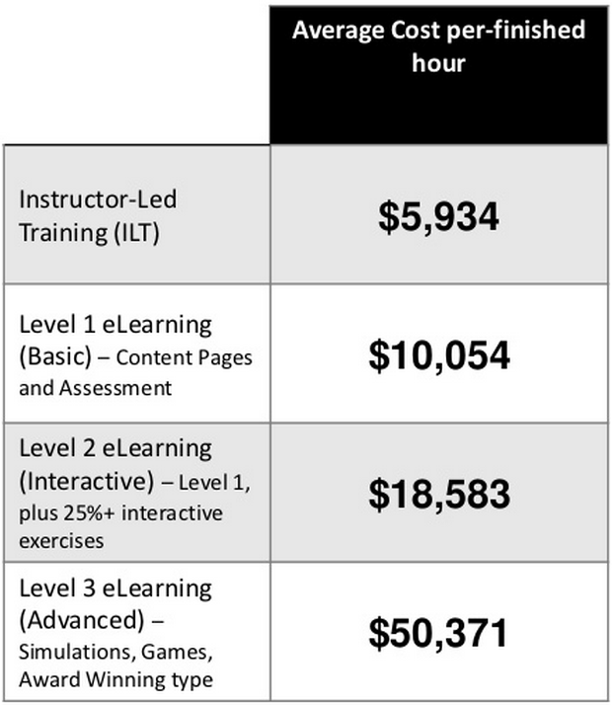
Development costs
data from 249 orgs & 3947 professionals, content consumed by 20M learners
http://www.slideshare.net/bchapman_utah/how-long-does-it-take-to-create-learning
would it pay of for
12 courses * 16 kEUR +20% curriculum + 60 kEUR fixed = cca 290 kEUR
Notes:
http://www.slideshare.net/bchapman_utah/how-long-does-it-take-to-create-learning
http://www.slideshare.net/satishverma66/e-learninghow-to-develop-elearning-from-start-to-end?related=1

Slide 37
Development as an Erasmus+ project
Notes:
Kibi-dabi 10 k/course, 1yr,, 40 kFIX =>150 kEUR
Erasmus+ Staff costs
Manager 88 EUR/day
Teacher/Trainer/Researcher/Youth worker 74 EUR/day
Technician 55 EUR/day
Administrative staff 39 EUR/day

Slide 38
Risks
Lack of interest
Students – attractiveness, tuition fees, competition, … ?
Teachers - required skills, preparation, effort, … ?
Institution authorities – fear of „bad reputation”, … ?
Drop-out rate
virtual environment, lack of support, self-esteem …
Sustainability
Technical feasibility
Cost-benefit
Notes:
Diskusija
http://www.open.edu/openlearn/#

Slide 39
The master plan
Expression of Interest
Establish a working group
Budgeting: by project, institution(s), …
Curricula development & accreditation
Course development
Preparation of resources (infrastructure, HW, SW, …)
Preparation of administrative support
Establish a technical support
Legal issues (contracting, intellectual rights, etc.)
… deadline(s)?

Slide 40
Would YOU involve ?
In-house development (probably free of charge development)
Split development and CopyPaste, e.g. „DAAD” approach ☺
Erasmus+ KA2 project
Inter-university study program ?
Notes:
Brainstorming / discussion
https://moodle.carnet.hr/
http://www.carnet.hr/ela
http://www.mastersportal.eu/studies/14029/project-management.html
http://www.doba.hr/hr/doba-fakultet/
http://www.megatrend-edu.net/wwstr.php?bs=s8&language=1&language=0&language=1
http://www.open.edu/openlearn/
http://distancelearning.ubc.ca/
http://techined.ualberta.ca/onlineblended
http://www.ed.ac.uk/schools-departments/support-services

